Slide 1
Unit 5: Week 1
Grade 4

Slide 2
Copyright © Savvas Learning Company LLC. All Rights Reserved.
This publication is protected by copyright, and permission should be obtained from the publisher prior to any prohibited reproduction, storage in a retrieval system, or transmission in any form or by any means, electronic, mechanical, photocopying, recording, or otherwise. For information regarding permissions, request forms, and the appropriate contacts within the Savvas Learning Company Rights Management group, please send your query to:
Savvas Learning Company LLC, 15 East Midland Avenue, Paramus, NJ 07652
or
k12learningpermissions@savvas.com
myView Literacy® is an exclusive trademark of Savvas Learning Company LLC in the U.S. and/or other countries.

Slide 3
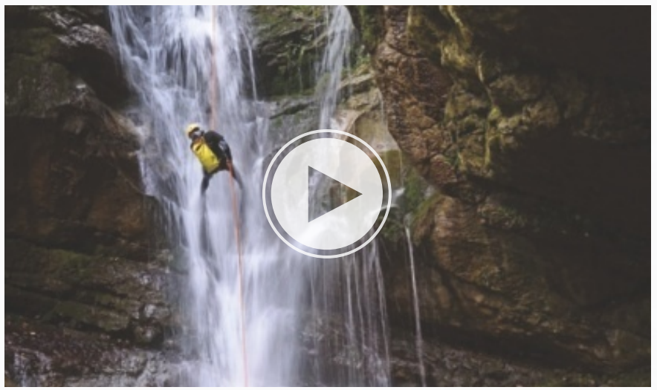
Page 426
Introduce the Unit
Essential Question:
Why is it important to
understand our planet?
How do the visuals show why scientists study Earth’s features?
What uncommon sounds in the video help you understand more about the planet?
Notes:
Introduce the Essential Question for Unit 5: Why is it important to understand our planet? Tell students they will read many texts to learn about the planet.
Watch the Unit Video – Tell students that a video combines sound and pictures. Have students watch “Our Planet” and make a list of what they learn about Earth and the people who study it. Click Path: Table of Contents -> Unit 5: Our Traditions -> Unit 5: Introduction -> Unit 5 Video: Our Planet
Encourage partners to discuss what they learned about Earth’s features by watching the video. Use the following questions to guide their discussions.
How do the visuals show why scientists study Earth’s features?
What uncommon sounds in the video help you understand more about the planet?

Slide 4
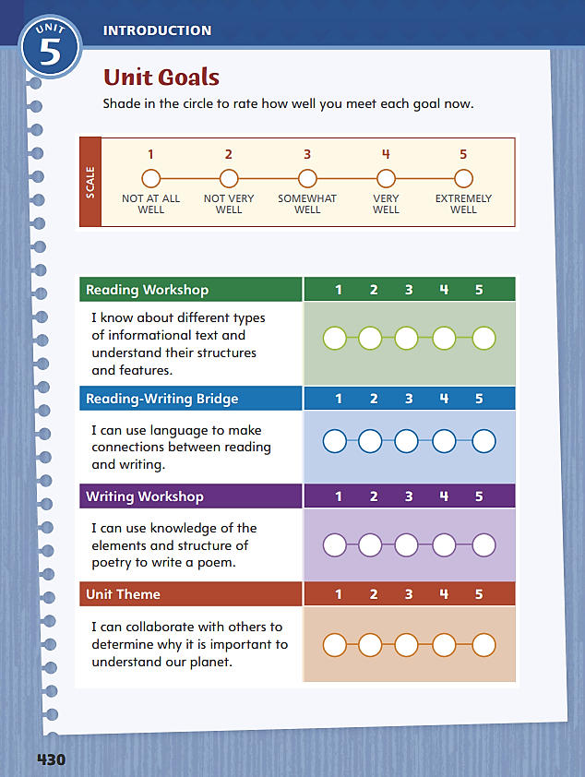
Page 430
Unit Goals
Turn to page 430 in your Student Interactive.
Shade in the circle to rate how well you meet each goal.
Notes:
Review the Unit Goals on p. 430 of the Student Interactive.
Have students rate how well they think they already meet the unit goals.
Have them use their ratings to reflect on how well they are meeting their personal learning goals during the unit.
Students will revisit their ratings in Week 6.

Slide 5
Page 431
Academic Vocabulary
Expand: I was _____ when I saw a bright rainbow after the storm.
Ask: What have you seen in nature that _____ you?
Expand: The United States map shows the _____ between the states.
Ask: What states are on the _____ of Texas?
Expand: A ________ is the result of an action.
Ask: What are the ________ of missing the bus?
Expand: I ____ my office supplies to keep them organized.
Ask: What kinds of ____ do you see in the classroom?
Expand: A museum ______ important objects from the past.
Ask: How does a refrigerator ______ food?
Notes:
Explain that academic vocabulary is language used to discuss ideas. As students work through the unit, they will use these words to discuss features.
Read each word’s definition. Have students respond to the Expand and Ask questions using the newly acquired academic vocabulary as appropriate.
Have students complete the chart on p. 431 for the listed words. Then have partners share their answers.

Slide 6
Lesson 1

Slide 7
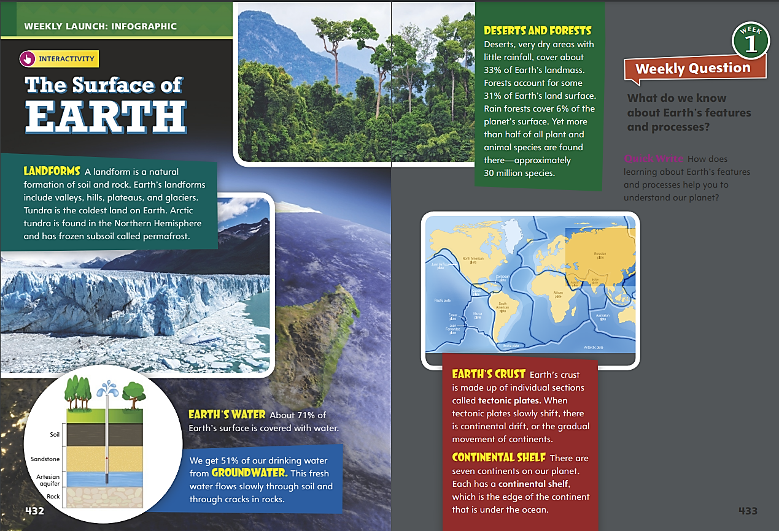
Page 432, 433
Interact with Sources
Read the infographic and discuss different kinds of features found on Earth’s surface.
Answer the Quick Write question on p. 433.
Notes:
Remind students of the Essential Question for Unit 5: Why is it important to understand our planet?
Point out the Week 1 Question: What do we know about Earth’s features and processes?
Direct students’ attention to the infographic on pp. 432–433 in the Student Interactive. Remind them that an infographic uses text and visuals to impart information.
Have students read the infographic and discuss the different kinds of features found on Earth’s surface. Use the following questions to guide discussion:
What facts about Earth’s surface surprised you?
Which of Earth’s features is the most interesting to you?
What inference can you make about rain forests? Use evidence to support your inference.
Reread the Week 1 Question: What do we know about Earth’s features and processes?
Tell students that they just learned about some of Earth’s features and processes. Explain that they will read more about Earth this week.
Freewrite - Have students answer the Quick Write question on p. 433 and then share their responses.

Slide 8
Listening Comprehension
MANAGING GARBAGE
Waste-to-Energy | Landfills
Notes:
Tell students you are going to read aloud an informational text called “Energy Recovery of Waste.”
Have them actively listen, paying close attention to descriptive details. After they read, have them paraphrase the text, maintaining the text’s order.
READ ALOUD ROUTINE Have students actively listen for elements of informational text.
Read the entire text aloud without stopping for Think Aloud callouts.
Reread the text aloud, pausing to model Think Aloud strategies related to the genre and the text features.
Say: I see there is a heading in the first half of the text. Text features like headings tell me this is probably an informational text. I know informational texts relate facts and ideas on a topic. Their features organize the information into topics. Sometimes they use graphic features like pictures and diagrams as well, which help make the facts and ideas clear.
Say: As I continue to read the text, I notice that there are three more headings on this page. The headings break up the text into three sections and tell me what each section is about: a new way to recycle, how waste-to-energy works, and the benefits of waste-to-energy. The headings also tell me where I can find the information about each of these topics if I ever need to come back and look for it.
Use a T-chart to help students compare waste-to-energy with landfills.

Slide 9
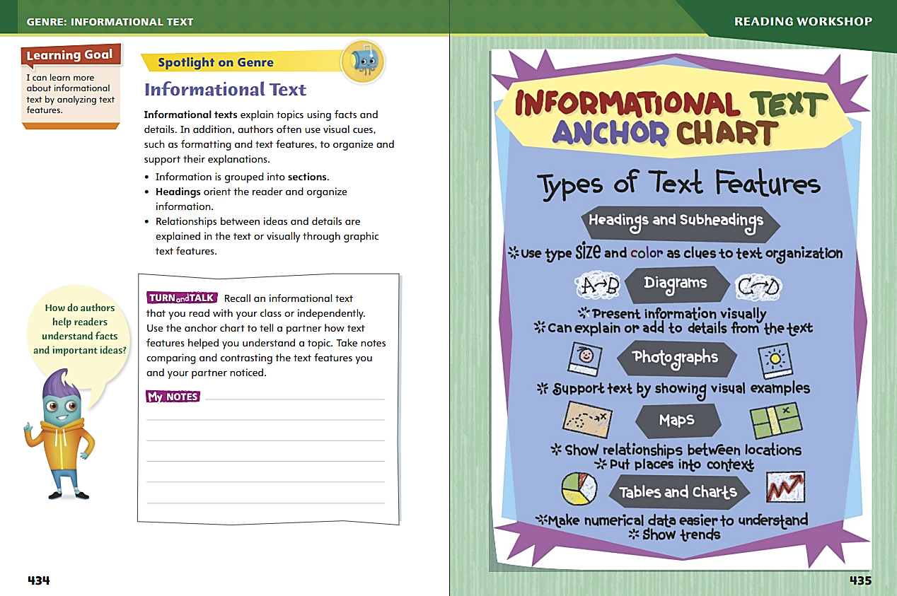
Page 434, 435
Informational Text
Turn to page 434 in your Student Interactive.
Notes:
Explain to students that authors of informational text often use text and graphic features to help organize and clarify information. Sections, headings, and subheadings are common text features of informational text. Graphics such as diagrams, photographs, maps, tables, and charts display and clarify information to help readers better understand the text.
Look for features that tell you a selection is informational text, such as headings, diagrams, photographs, charts, tables, and maps.
Ask yourself how the information in a text is organized or structured. What text features are used and what topics do they include?
Think about how the features help you understand the information.
Model analyzing informational text features. Say: In “Energy Recovery of Waste,” the author uses text features like headings to help the reader learn about the topics in the work. I ask myself, “What do these text features do?” The headings help organize the information in the text.
Talk about what graphic text features could be added to “Energy Recovery of Waste.” Discuss how graphic features would help readers understand some of the ideas in the text.

Slide 10
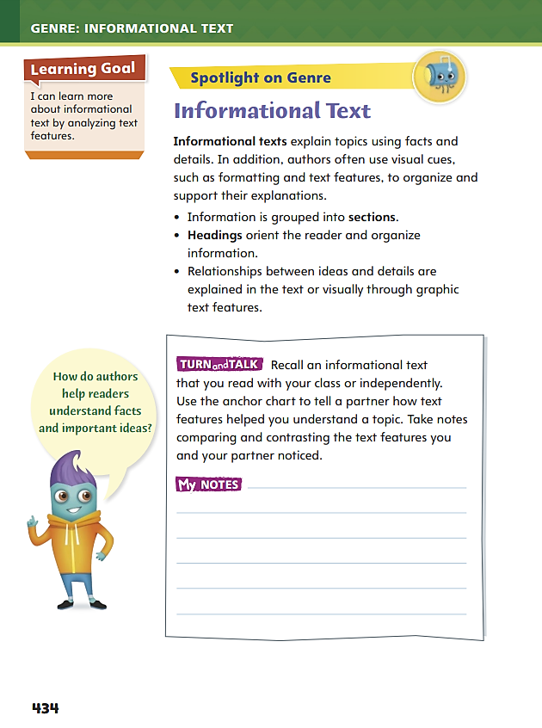
Page 434
Apply
With a partner, discuss how informational text
features helped you understand a topic.
Take notes on your discussion.
Notes:
Have students use the strategies to identify informational text.
Have students work with a partner to complete the Turn and Talk on p. 434 of the Student Interactive.
Circulate to discover whether students can recognize characteristics of informational text.

Slide 11
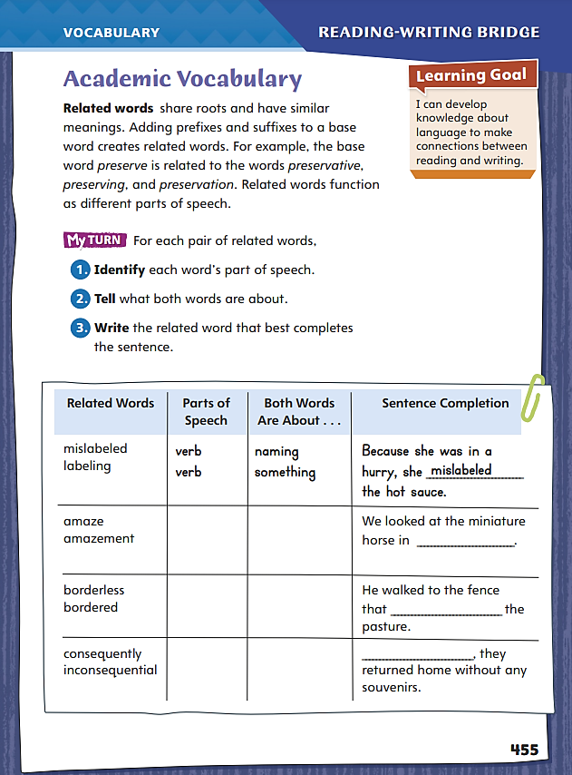
Page 455
Academic Vocabulary
Look for words with familiar base words.
Notice prefixes and suffixes that change the meaning of the base word.
Pay attention to how prefixes and suffixes change the word’s part of speech.
Notes:
Explain to students that related words stem from a single base word and branch out to form different words that perform different functions within a sentence. For example, rotator, rotation, and rotational all come from the base word rotate, which means to “turn in a circle.”
Look for words with familiar base words. Notice prefixes and suffixes that change the meaning of the base word.
Pay attention to how prefixes and suffixes change the word’s part of speech. For example, rotate is a verb, rotator and rotation are nouns, and rotational is an adjective.
Model using related words in the chart on p. 455 in the Student Interactive.
Say: I see two words about naming something. Mislabeled means “incorrectly named something.” Labeling means “putting a name tag on.” Because of the context clue about being in a hurry, I will complete the sentence with the word that uses the prefix mis-, for “bad or wrong.”
Ask students to apply the same strategy for a different word.

Slide 12
Page 455
Apply
Identify each word’s part of speech.
Tell what both words are about.
Write the related word that best completes the sentence.
Notes:
Have students follow the same strategy to complete the chart on p. 455.
Remind students that they will use forms of the academic vocabulary words throughout the unit.

Slide 13
Word Study – Latin Roots
generation
enduring
project
import
regenerate
Notes:
Point out that Latin roots are typically not whole words but parts of words that are used to generate other words.
Present Latin root gener, and ask students to tell how it is related to the word generate. Ask a volunteer to define generate (to produce), and tell students that all words with gener have something to do with producing.
Present the meaning of each Latin root:
gener (to produce)
port (to carry)
dur (to harden)
ject (to throw)
Write the following words, and ask students to identify each Latin root, prefix, or suffix, and define the word.
generation
enduring
project
import
regenerate
Emphasize how the meaning of the Latin root is retained in each word.

Slide 14
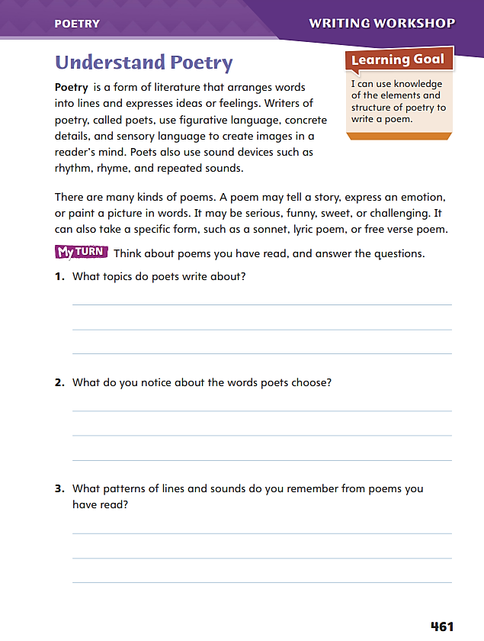
Page 461
Writing – Poetry
Turn to page 461 in your Student Interactive.
Notes:
Explain that poetry is defined by its form, language, and rhythm or sound. Like all writers, poets have a purpose, which may be to
tell a story,
express an emotion,
or evoke an image with words.
To achieve his or her purpose, a poet may use a specific type of poem, such as a sonnet, a lyric poem, or a free-verse poem.
Inform students that they will be reading different kinds of poems to prepare for their own poetry writing. Read aloud from the stack and discuss the characteristics and craft of poetry:
Identify the title and topic of the poem.
Display the poem. Ask: How is the written form of poetry different from other genres we have read?
Point out line breaks and stanzas.
Have students echo-read the poem. Discuss the rhythm or rhyme established in the poem.
Direct students to p. 461 in the Student Interactive. Have them read aloud additional poems from the stack with a partner and then complete the activity independently.

Slide 15
Independent Writing
Brainstorm the purpose and topic of your poem in your writer’s notebook.
Share the topic, language, and patterns you identified in the poems you read.
Notes:
After the genre immersion lesson, students should transition into independent writing. If students need additional opportunities to develop their understanding of poetry, invite them to read more poems from the stack. I
If students struggle, choose one of the following options to provide further support.
Modeled – Choose a poem from the stack, and do a Think Aloud to model thinking about the purpose of the poem and noticing the poetic language.
Shared – Prompt students to identify sensory or descriptive language they enjoy from a poem in the stack. Have students share drawings based on the imagery.
Guided – Use the stack texts to provide explicit instruction on identifying elements of poetry. Identify language and structure from the text that identifies it as a poem
If students demonstrate understanding, they should transition to brainstorming the purpose and topic of their poem in their writer’s notebook.
At the end of writing time, invite volunteers to share the topic, language, and patterns they identified in the poems they read.

Slide 16
Spelling
Jory is generous with both his time and his money.
The 800-meter dash is both a sprint and an endurance race.
If you make noise during the play, they will eject you from the theater.
The senator has a major objection to the budget bill.
This leather is both beautiful and durable.
My dad once had a job running a projector in a movie theater.
This new laptop is powerful and completely portable.
The debate started out well, but soon degenerated into an argument.
In general, most of the debates were highly productive.
We need to find out how to transport a sofa to New Mexico.
Notes:
(Note: Move the orange boxes to cover each bold spelling word before you read aloud the words and sentences.)
Use the Spelling Sentences from Day 5 to assess students’ prior knowledge of Latin roots.
Jory is generous with both his time and his money.
The 800-meter dash is both a sprint and an endurance race.
If you make noise during the play, they will eject you from the theater.
The senator has a major objection to the budget bill.
This leather is both beautiful and durable.
My dad once had a job running a projector in a movie theater.
This new laptop is powerful and completely portable.
The debate started out well, but soon degenerated into an argument.
In general, most of the debates were highly productive.
We need to find out how to transport a sofa to New Mexico.
Reveal the spelling word and have students check their work.
For students who understand how affixes impact the spelling of words with Latin roots, include the following Challenge Words with the spelling list. Challenge Words: portmanteau, trajectory, obdurate.

Slide 17
Language and Conventions
Fill in each superlative for the adjective in parentheses in the sentences below.
This suit is made from some of the (fine) ______ cloth in the world.
Jody makes the (good) ____ peach pie in the state.
Why did we need to plan a picnic on a day with the (bad) ____ weather of the year?
I felt that the book was the (hilarious) ____ _______ thing I’d ever read.
Notes:
Review superlative adjectives as words that compare more than two items. Superlatives take three forms:
-est ending (slowest)
most + adjective (most inventive)
irregular (least)
Provide several examples. See Volume 4, p. T354.
Have students fill in each superlative for the adjective in parentheses in the sentences below.
This suit is made from some of the (fine) finest cloth in the world.
Jody makes the (good) best peach pie in the state.
Why did we need to plan a picnic on a day with the (bad) worst weather of the year?
I felt that the book was the (hilarious) most hilarious thing I’d ever read.
Invite partners to write their own sentences using superlatives, exchange papers, and identify each superlative.

Slide 18
Lesson 2

Slide 19
Preview Vocabulary
mantle
circulates
adopted
abundant
molten
Notes:
Introduce the vocabulary words on p. 436 in the Student Interactive, and define them as needed.
mantle: the layer of Earth between the crust and the core
circulates: moves through a system
adopted: started to use a selected idea or method abundant:
plentiful; commonly occurring
molten: melted; hot enough to be in liquid form
Say: As you read, highlight these words when you see them in the text. Ask yourself how they help you understand Earth’s structure, surface, and processes.

Slide 20
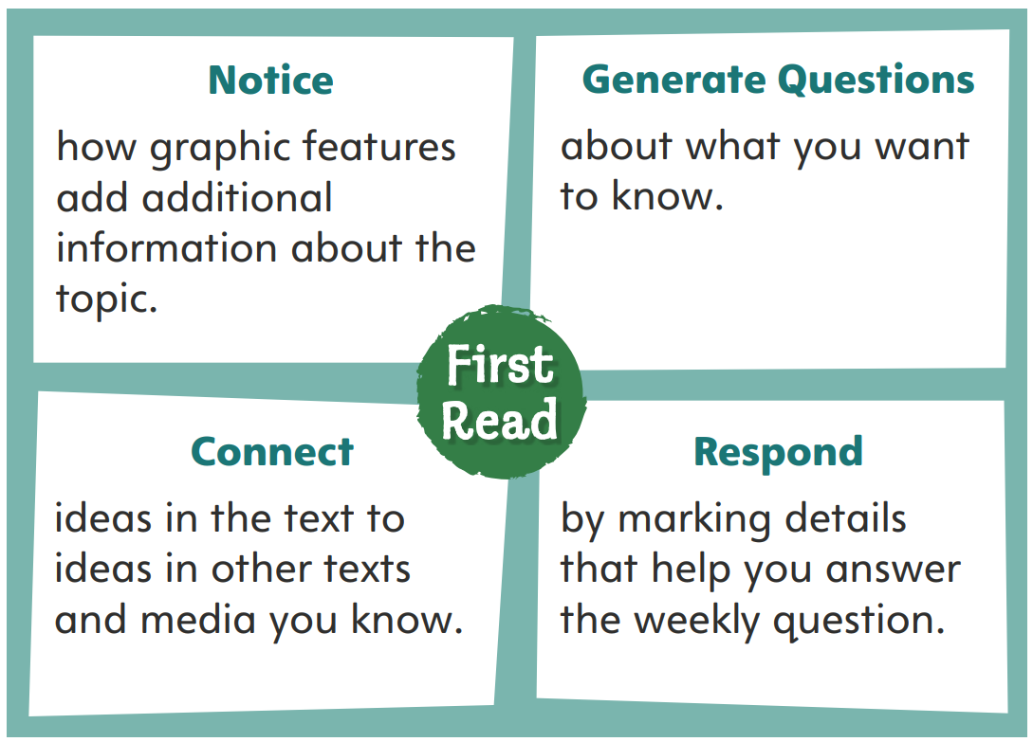
Page 436
First Read Strategies
Notes:
Discuss the First Read Strategies.
NOTICE - Tell students to focus on the graphic features on each page before they read.
GENERATE QUESTIONS - Direct students to ask questions about what interests them
CONNECT - Remind students to connect information in this text to information or ideas they have encountered in other texts or media.
RESPOND - Have students keep the weekly question nearby as they read.
Prompt students to establish that the purpose for reading this selection is to learn new information.
Direct students to scan the text features and make predictions about what they might learn.
Students may read independently, in pairs, or as a class. Use the First Read notes to help them connect with the text and guide their understanding.

Slide 21
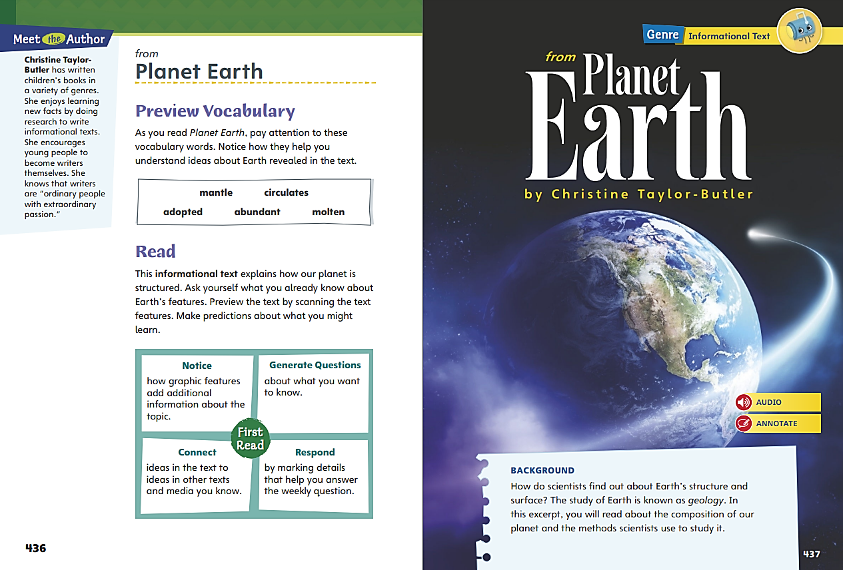
Page 436, 437
First Read – Planet Earth
Notes:
Read the text. Pause to discuss the First Read notes with students.

Slide 22
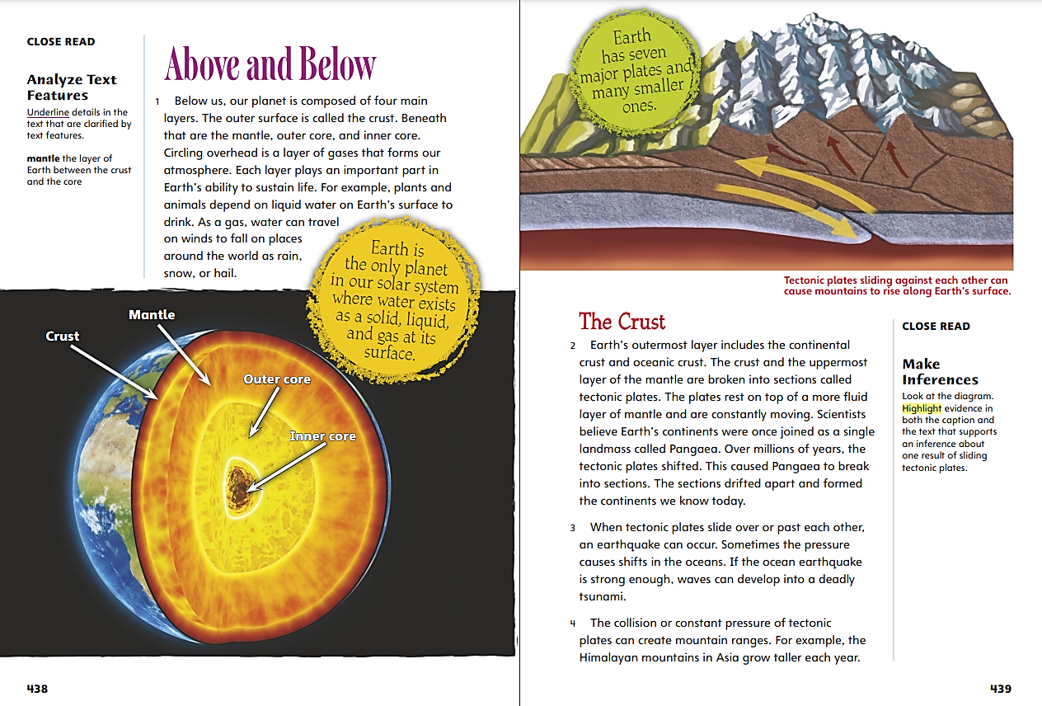
Page 438, 439
First Read – Planet Earth
Notes:
Read the text. Pause to discuss the First Read notes with students.
Direct students’ attention to the diagram on p. 438.
Say: I notice that there is a picture that shows and labels the four layers of Earth described in the text. This kind of picture is called a diagram.
Say: As I read, I will look for connections between Planet Earth and other texts and media that I have experienced. I see that this section of the text is about Earth’s crust. What else have we read this week about Earth’s crust?

Slide 23
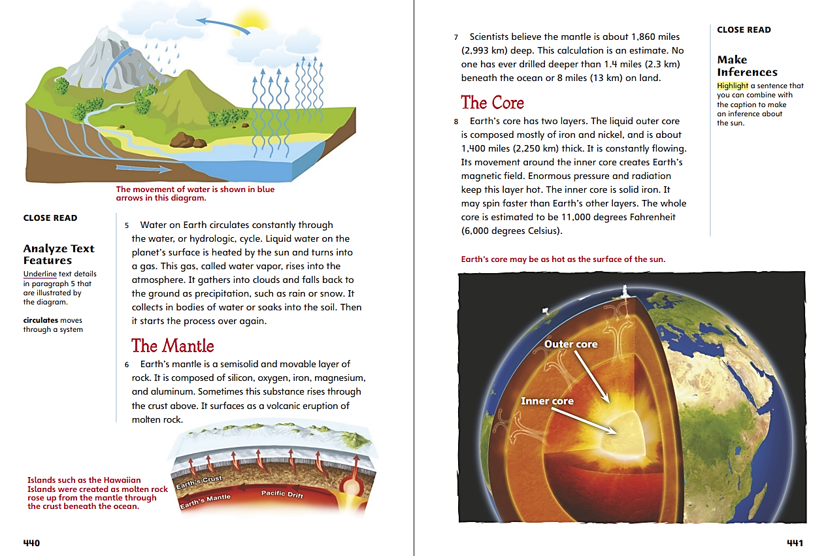
Page 440, 441
First Read – Planet Earth
Notes:
Read the text. Pause to discuss the First Read notes with students.
Say: I’ll find out what the diagram on page 440 shows. The caption tells me it shows the movement of water with blue arrows. This connects to text information about the water cycle.
Say: I find it surprising that Earth’s inner core is solid iron and that it is very hot. The diagram helps me visualize how the Earth’s core may be as hot as the sun’s surface.

Slide 24
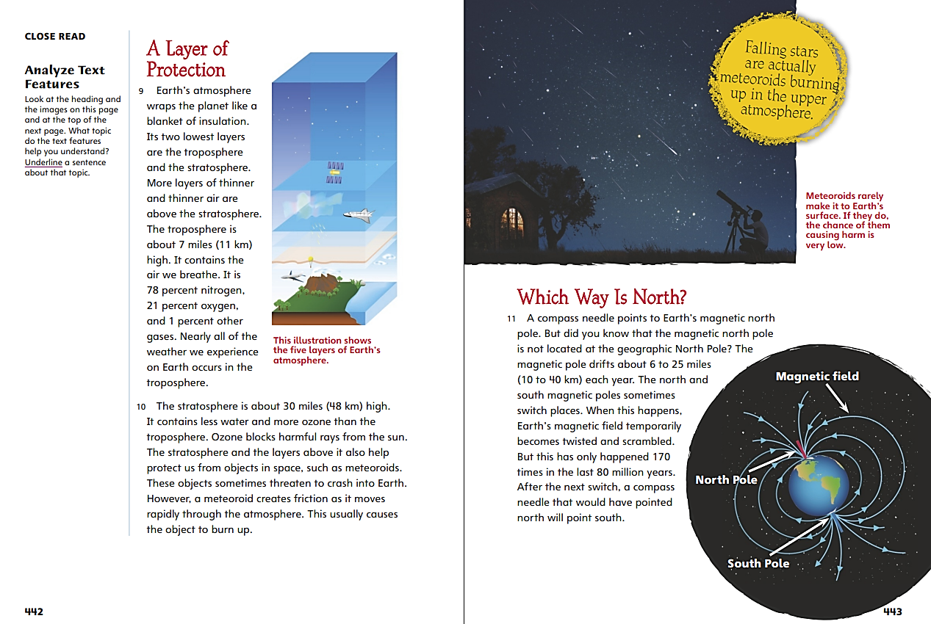
Page 442, 443
First Read – Planet Earth
Notes:
Read the text. Pause to discuss the First Read notes with students.
Say: The question for this week is What do we know about Earth’s features and processes? This passage explains one of Earth’s features—its atmosphere. I can mark details about the atmosphere to help me answer the Weekly Question.
Say: I notice that Earth is magnetic. That makes sense since its core is made of iron, which is a metal. That is how a compass works: it points to Earth’s magnetic North Pole. I also notice from the picture and caption that meteors seldom land on Earth.

Slide 25
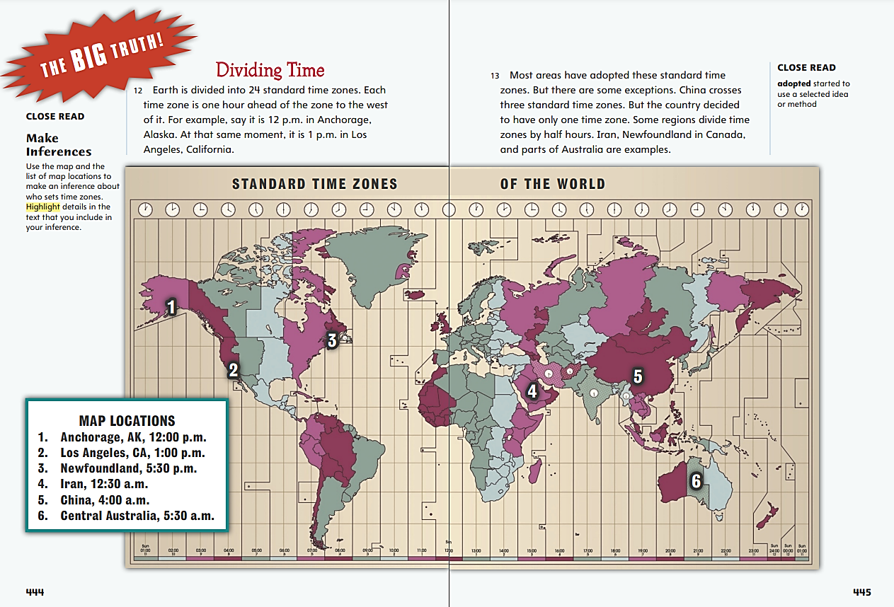
Page 444, 445
First Read – Planet Earth
Notes:
Read the text. Pause to discuss the First Read notes with students.
Say: I can look closely at the graphic features and paraphrase, or summarize, the quantitative information that is presented visually. I need to think about what the map adds to the information in paragraphs 12–13, and how the map supports the text.
Responses will vary, but students should talk about how the map helped them visualize time zones and should find details in the text that relate to the map.
Say: I can look back at the map to help me understand what I have read.

Slide 26
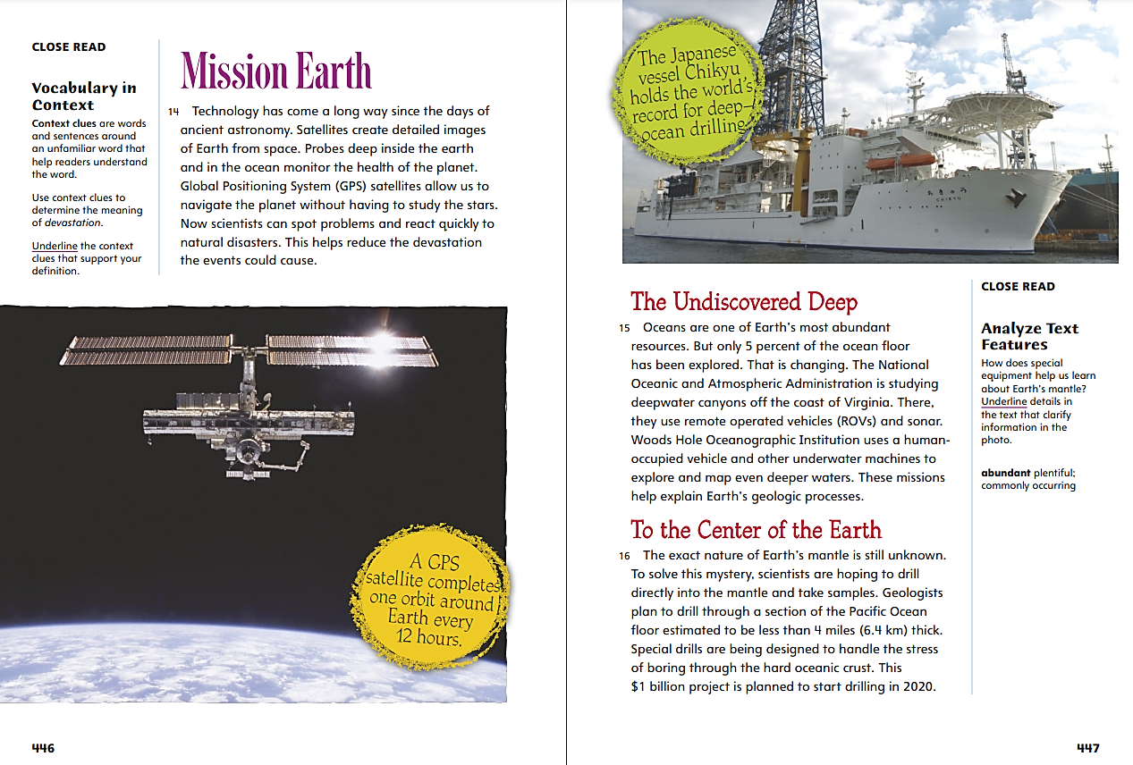
Page 446, 447
First Read – Planet Earth
Notes:
Read the text. Pause to discuss the First Read notes with students.
Say: This section tells how technology helps us understand Earth. The picture and part of the text give information about GPS satellites. What else have you read or do you know about GPS?
Possible response: People use GPS in cars and on their phones. It helps them use maps and get accurate, personalized directions.
Say: I have a question about the photo of the ship. How does that relate to Earth’s features and processes? The caption tells me that the ship is used to drill under the ocean, so it might reveal information about Earth’s structure. The headings also hint at what is deep below the surface.

Slide 27
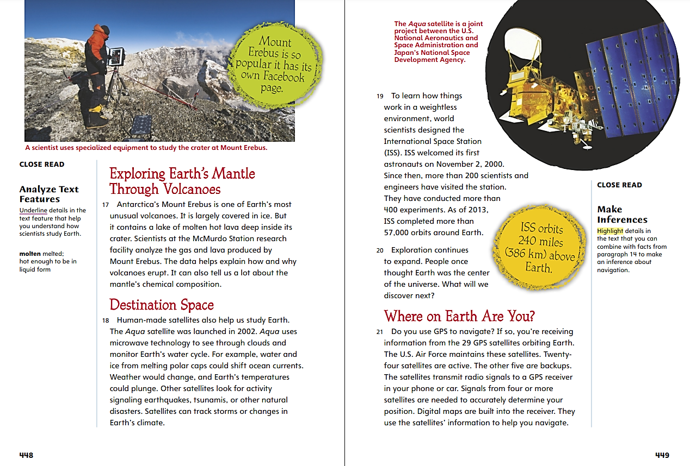
Page 448, 449
First Read – Planet Earth
Notes:
Read the text. Pause to discuss the First Read notes with students.
Say: This picture of Mount Erebus shows a volcanic crater. The vapor in the background could be hot gas from the volcano. The text states that Mount Erebus has “molten hot lava deep inside its crater.”
Say: The text ends with information about satellites in outer space. I have seen several movies about outer space that feature satellites.

Slide 28
Respond and Analyze
Brainstorm: What would you like to learn more about?
Discuss: How did reading Planet Earth help you understand Earth?
Notes:
Begin by having students share what in the text interested them the most. Use these suggestions to prompts students' initial responses to Planet Earth.
Brainstorm - What would you like to learn more about?
Discuss - How did reading Planet Earth help you understand Earth?

Slide 29
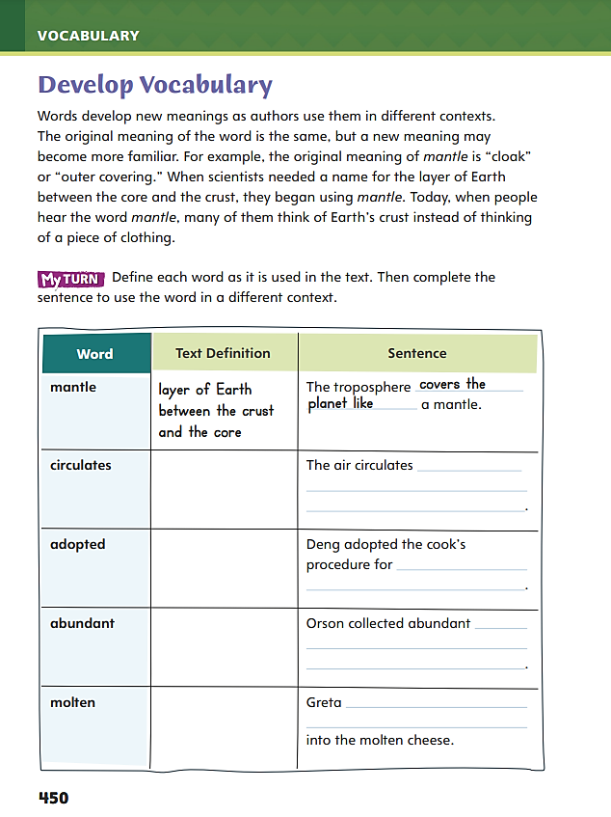
Page 450
Develop Vocabulary
Turn to page 450 in your Student Interactive and complete the activity.
Notes:
Tell students that words have different meanings depending on the context in which they are used. The meanings of the vocabulary words mantle, circulates, adopted, abundant, and molten can change based on their context.
Remind yourself of each word’s meaning or meanings.
Ask yourself how the context helps you determine the relevant meaning.
Model filling out the first row in the chart on p. 450.
Say: The word mantle has more than one meaning. In Planet Earth, it means “the layer of Earth between the crust and the core.” I’ll write that definition in the chart.
Say: Another meaning of mantle is “cloak” or “outer covering.” I’ll complete the sentence in which mantle is used with that meaning.
Have students respond using newly acquired vocabulary as they complete p. 450 of the Student Interactive.

Slide 30
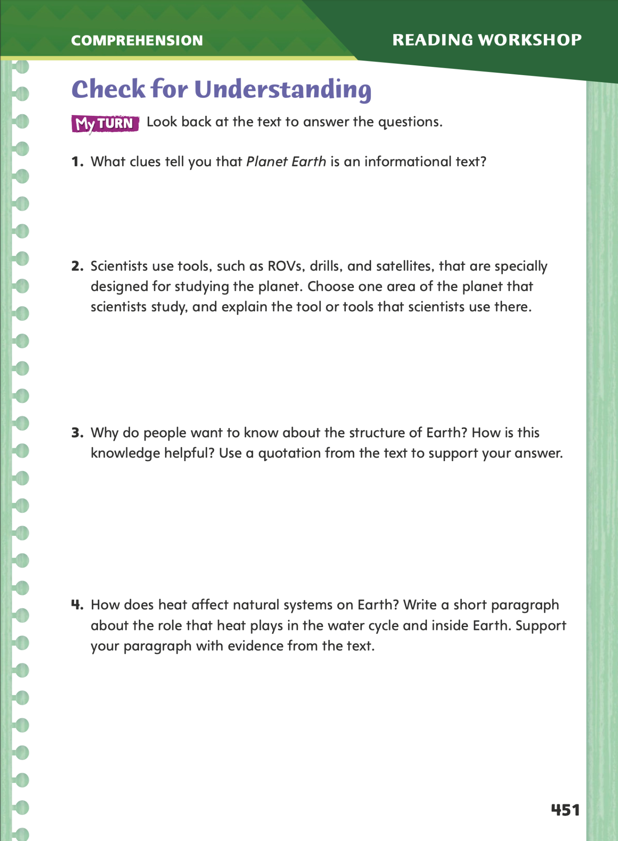
Page 451
Check for Understanding
Complete page 451 in your Student Interactive.
Notes:
Have students complete p. 451 of the Student Interactive.

Slide 31
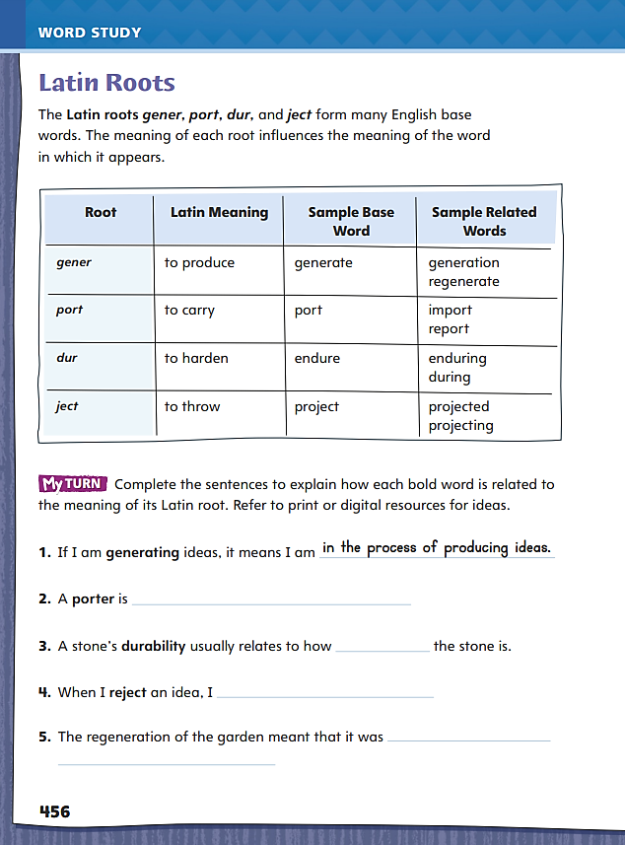
Page 456
Word Study – Latin Roots
Turn to page 456 in your Student Interactive and complete the activity.
List four more words with these Latin roots.
Notes:
Direct students to complete the sentences on p. 456 in the Student Interactive.
Then have students use print or digital resources to list four more words with these Latin roots.

Slide 32
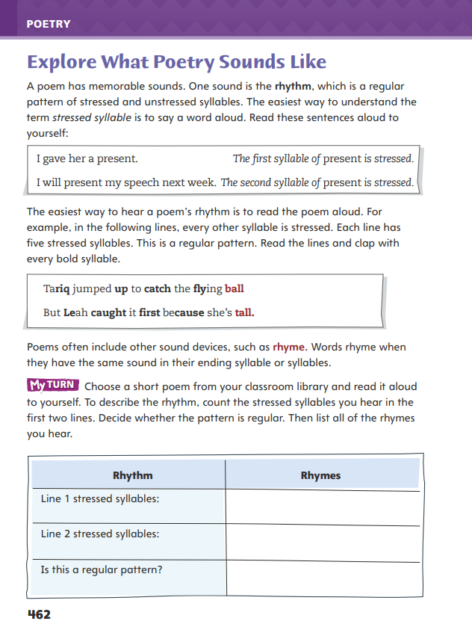
Page 462
Writing – Poetry
Turn to page 462 in your Student Interactive.
Notes:
Explain to students that because of its focus on sound, poetry is meant to be read aloud. It may have a regular beat like a song. This is the poem’s rhythm. Like a song, the rhythm may be fast or slow to complement the emotions or mood of the poem.
Explain that poets use other sound devices like rhyme to emphasize words and enhance the musical quality of the poem. Both rhythm and rhyme make a poem enjoyable to read and listen to.
Explore the sounds of poetry with students. Review p. 462 in the Student Interactive.
Discuss how differently stressed syllables can change the meaning of a word, such as present. Have students clap along to emphasize the regular pattern of the rhythm in the rhyming lines.
Ask: What do you notice about the words that end each line? (They rhyme.)
Display the lines and underline each ending syllable. Point out that in this poem, the rhyme is called end rhyme because the rhyming words are at the end of each line. Emphasize that rhyme can also occur within the lines of a poem.
Invite students to name other words that rhyme with the words on the board to demonstrate understanding of rhyme.
Direct students to the activity at the bottom of p. 462 in the Student Interactive. Have them use a poem from the stack and identify the rhythm and rhyme.

Slide 33
Independent Writing
Let’s try a new approach by reading aloud poems with a partner. Take turns emphasizing the rhythm and rhyme.
Share the lines from a poem you have read and identify the rhythm and rhyming words.
Notes:
After the genre immersion lesson, students should transition into independent writing. If students need additional opportunities to develop their understanding of the sounds of poetry, have them read aloud poems with a partner and take turns emphasizing the rhythm and rhyme
If students struggle, choose one of the following options to provide further support.
Modeled – Choose a stack text and do a Think Aloud to model identifying rhythm and rhyme in a poem.
Shared – Have students choose a poem from the stack. Ask them to read one line of a poem aloud and prompt them to identify the stressed syllables that establish the rhythm. Continue as needed. Encourage them to note any rhyming words.
Guided – Use the poems from the stack to provide explicit instruction line by line to identify the regular pattern of stressed syllables in a poem and words that rhyme.
Students who show understanding should be encouraged to start writing about their reasons in more detail.
At the end of writing time, ask student to share the orders in which they have arranged their reasons and why they did so.

Slide 34
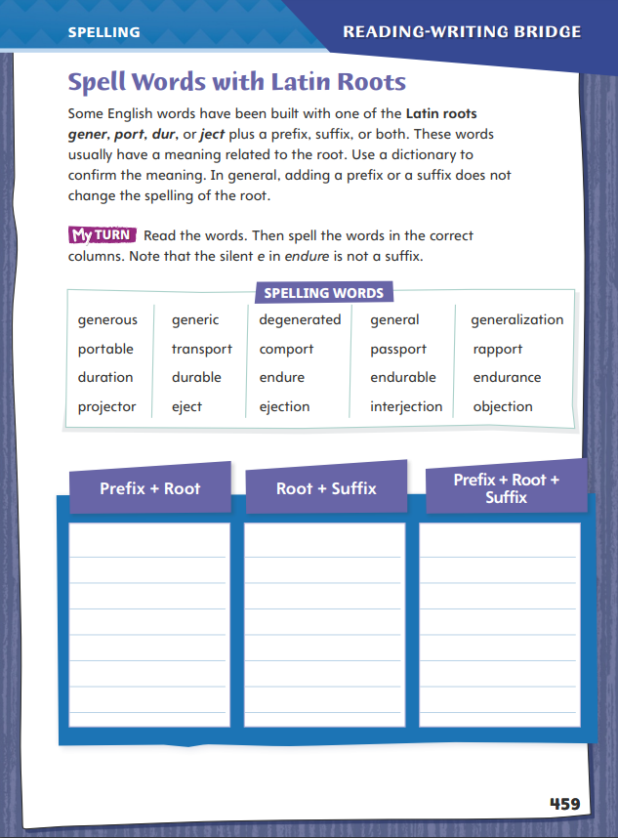
Page 459
Spelling- Latin Roots
gener
port
dur
ject
Turn to page 459 in your Student Interactive and complete the activity.
Notes:
Remind students that the Latin roots gener, port, dur, and ject can be found in many English words.
Point out that adding a prefix or a suffix does not generally change the spelling of these roots.
With the class, make a list of common prefixes and affixes that are found in words with Latin roots.
Help students recognize trans-, com-, -ous, -ation, and others.
Have students complete the activity on p. 459 of the Student Interactive.

Slide 35
Language and Conventions
Clause | Relative Adverb | Clause
I forgot | where | I put my hat.
We know | why | the cat escaped.
Ky laughed | when | Steve told a joke.
Think of a relative adverb that can connect the two clauses.
I do not know ____ the next train arrives at the station.
Notes:
Display the table and define relative adverbs as words that join two clauses or sentences and tell where, when, and why.
Write the following sentence on the board: I do not know ____ the next train arrives at the station. (when)
Ask students to think of a relative adverb that can connect the two clauses.
Go over these questions:
Ask yourself, what needs to be known — when, where, or why?
Fill in one of the relative adverbs.
Read the sentence to make sure that it makes sense.
Have students work in pairs to ask each other where, when, and why questions, then answer them in complete sentences using relative adverbs.

Slide 36
Lesson 3

Slide 37
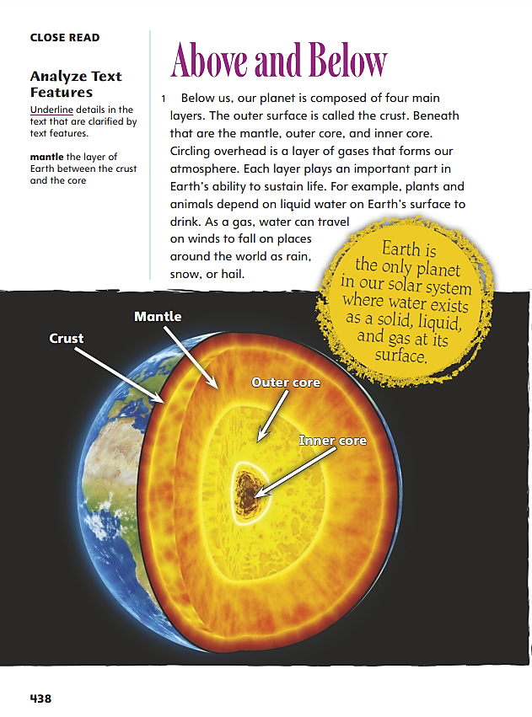
Page 438
Close Read – Analyze Text Features
Turn to page 438 in your Student Interactive.
Notes:
Explain that authors of informational text often use text features to organize or clarify information. By analyzing characteristics and structures of informational text such as graphic and print text features, readers can better understand important ideas in the text.
Pay attention to the text features that appear in the text.
Analyze the text features and how they connect to details in the text.
Ask yourself what purpose the author is trying to achieve with each text feature.
Use the Close Read note on p. 438 to model the thinking behind analyzing text features.
Say: What text features appear in Planet Earth? On page 438, I see a diagram of Earth. I’ll underline text details that are clarified by the diagram. I’ll write those details in the chart under “My Annotations.”
Say: Next, I’ll think about why the author included the diagram. I think it’s to explain Earth’s structure. I will write this purpose in the chart under “Purpose of Feature.”
Have students move on to the diagram of water movement on p. 440 and underline text details in paragraph 5 that are illustrated by the diagram. Then have them demonstrate understanding of characteristics and structures of informational text by writing those details and the purpose of the diagram in the chart.

Slide 38
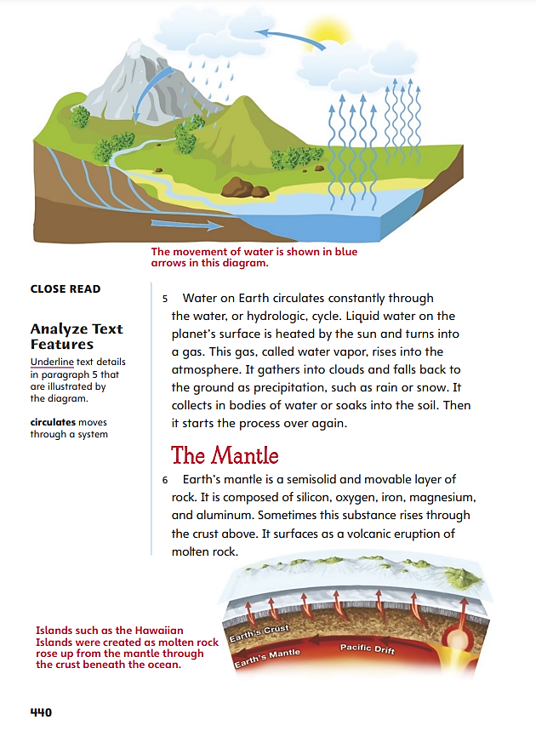
Page 440
Close Read – Analyze Text Features
Turn to page 440 in your Student Interactive.
Notes:
Have students annotate the text using the Close Read notes for Analyze Text Features.
Ask students to describe what characteristics and structures of informational text are present on the page. Possible response: Text features that support understanding, including diagrams, captions, and headings.
Have students scan paragraph 5 to find and underline text details that relate to the diagram. See student page for possible responses. Ask students to explain how these details are illustrated by the diagram.
Possible response: The details are illustrated by the upward and downward blue arrows in the diagram. DOK 2

Slide 39
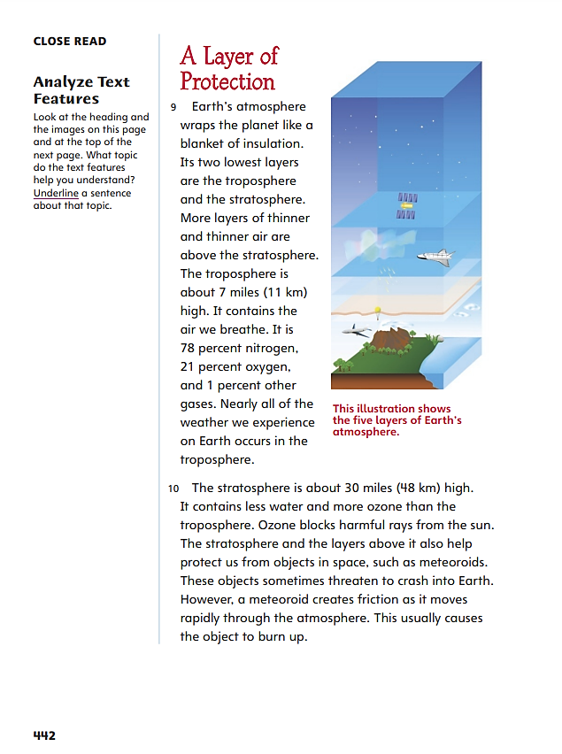
Page 442
Close Read – Analyze Text Features
Turn to page 442 in your Student Interactive.
Notes:
Have students annotate the text using the Close Read notes for Analyze Text Features.
Remind students to focus on the heading, diagram, and caption to quickly identify the topic. Then have them scan paragraphs 9–10 to underline a sentence about that topic. See student page for possible responses.
Ask students to use what they know about the characteristics and structures of informational text, including text features, to explain how the sentence helps them grasp the topic.
Possible response: The information relates to the text features and helps me understand the function of Earth’s atmosphere. DOK 2

Slide 40
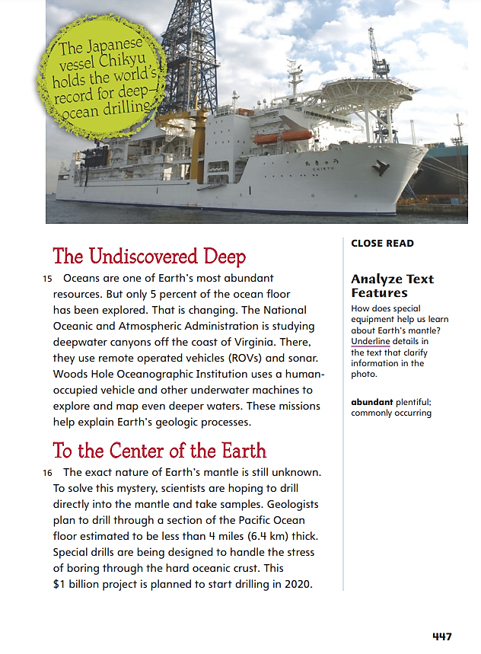
Page 447
Close Read – Analyze Text Features
Turn to page 447 in your Student Interactive.
Notes:
Have students annotate the text using the Close Read notes for Analyze Text Features.
Remind students that photos help readers of articles and nonfiction books visualize and grasp facts or ideas the author relates. Have students look at the photo and scan the caption and the text to underline details about equipment that can penetrate Earth’s mantle. See student page for possible responses.
Ask students how the details they underlined help clarify information in the photo.
Possible response: The caption clarifies that the photo shows a deep-ocean drilling vessel. The text details also help clarify this idea because they explain why the drill is on a ship. DOK 2

Slide 41
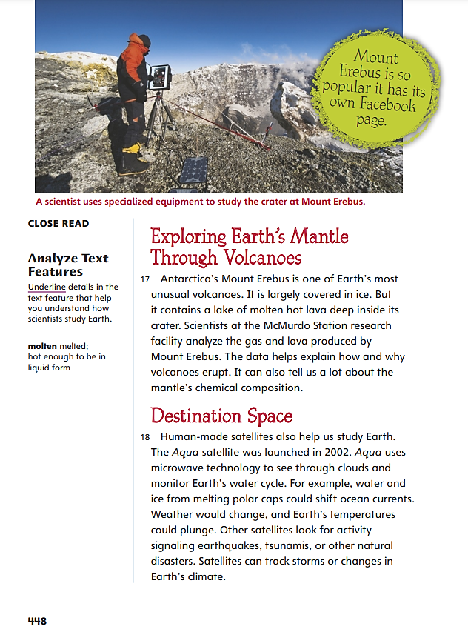
Page 448
Close Read – Analyze Text Features
Turn to page 448 in your Student Interactive.
Notes:
Have students annotate the text using the Close Read notes for Analyze Text Features.
Have students scan the photo caption and underline details about scientists studying Earth. See student page for possible responses.
Ask students to explain what the detail they underlined tells them about how scientists study Earth.
Possible response: The caption explains that scientists use specialized technology to study the Earth. DOK 1

Slide 42
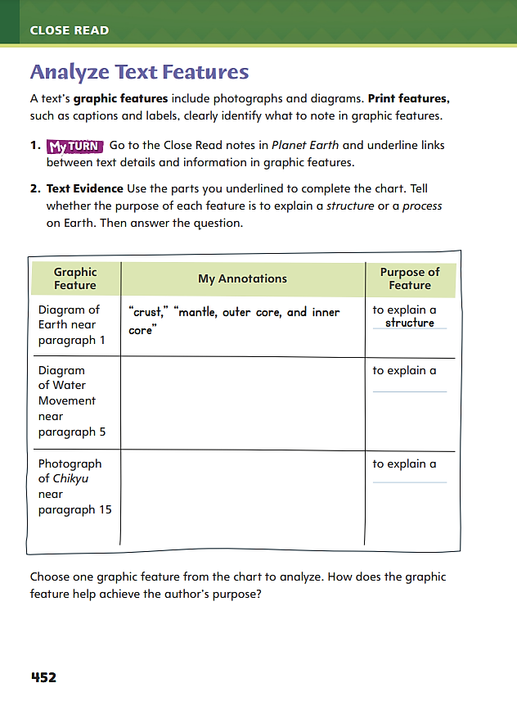
Page 452
Analyze Text Features
Turn to page 452 in your Student Interactive and complete the activity.
Notes:
Have students annotate the text using the Close Read notes for Analyze Text Features.
then ask students to use their annotations to complete the chart on p. 452.

Slide 43
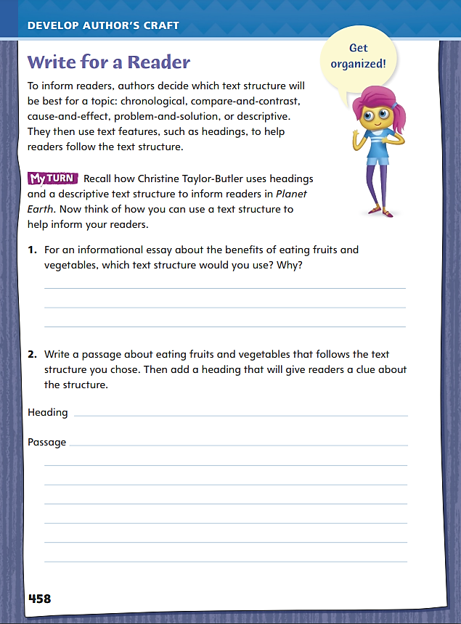
Page 458
Read Like a Writer, Write Like a Reader
Turn to page 458 in your Student Interactive.
Notes:
In an informational text, readers should be prepared to recognize a variety of different text structures.
A chronological text structure lists story events in time order, with the first event coming first, the second event second, and so on.
A compare-and-contrast structure compares characteristics of two different items one by one.
A cause-and-effect structure can show a small number of causes producing many effects, or multiple causes producing a small number of effects.
A problem-and-solution text structure identifies a problem, builds a case by collecting supporting evidence, organizes the evidence into a logical sequence, then draws a single solution.
A descriptive structure describes as many characteristics as possible and lets the reader connect the dots and draw a conclusion.
Model this strategy for identifying and analyzing text structure on p. 458 in the Student Interactive.
Say: I first identify what the topic is and look at headings to see how the text is organized.
Say: I try to match the text to a text structure by going through each text structure one by one. Is information presented in a time sequence? If so, I have a chronological text structure. If the text identifies aspects of two different items side by side, I have a compare-and-contrast text structure. I go through a similar process for the other structures.

Slide 44
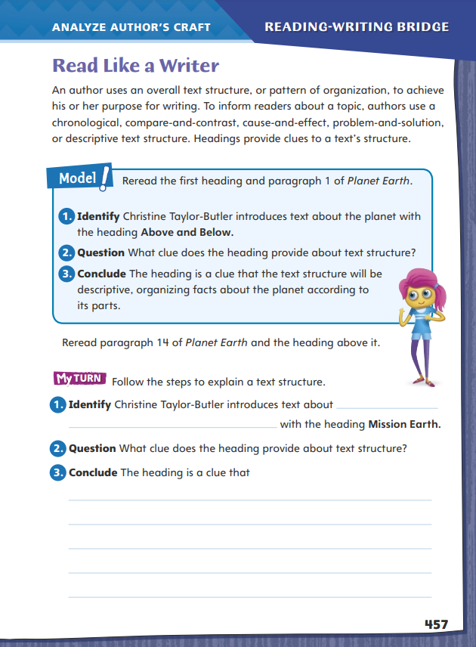
Page 457
Apply
Turn to page 457 in your Student Interactive and complete the activity.
Notes:
Ask students to go through the selection, paying attention to the author’s use of headings.
Explain that headings can provide clues to text structure.
Then have students complete the activities on p. 457.

Slide 45
Word Study – Latin Roots
duration
export
rejection
generational
projectile
Identify the Latin root and any prefixes and suffixes. Provide a definition of each word.
Notes:
Remind students that they can come up with a reasonable definition of a word by combining the meanings of the Latin root, prefixes, and suffixes.
Display the following words: duration, export, rejection, generational, projectile.
Ask students to identify the Latin root and any prefixes or suffixes, and to provide a reasonable definition of each word.
Have students complete Word Study p. 177 from the Resource Download Center. Click path: Table of Contents -> Resource Download Center -> Word Study -> U5W1 Word Study

Slide 46
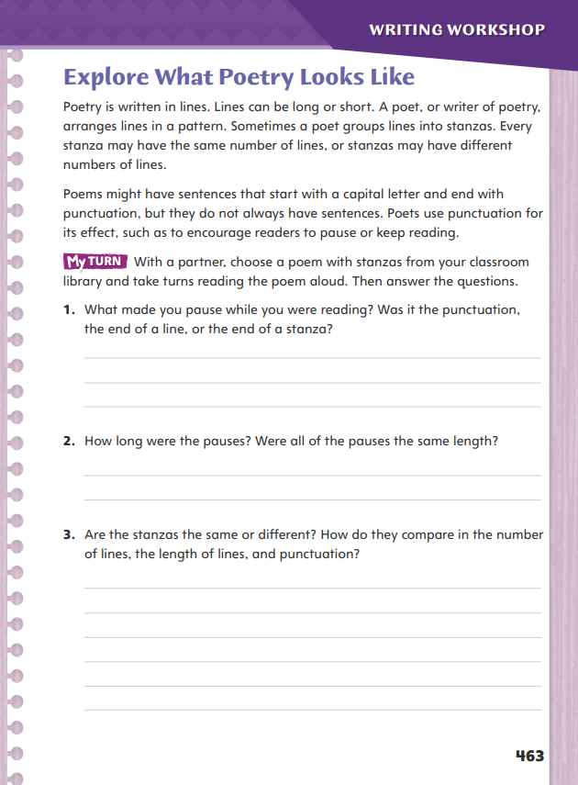
Page 463
Writing – Poetry
Turn to page 463 in your Student Interactive and complete the activity.
Notes:
Explain that poetry, unlike other formal written genres, does not need to follow formal writing conventions. Poets may write in complete sentences, but they do not have to. Instead, they separate ideas into lines and stanzas.
Ask: How is poetry different from other genres? After students share answers, direct their attention to p. 463 in the Student Interactive.
Invite students to share some of their favorite and most memorable lines from poems they have read so far. Record them on the board. Then note whether the line is a complete sentence with a subject and verb. Discuss what makes the line memorable or unique.
Write or show a stanza from a poem to students. Read the lines aloud, and ask students to notice the pauses as you read. Pay attention to punctuation; give a short pause at commas and a longer pause at end punctuation. Discuss the pauses with students.
Invite students to notice other aspects of a poem’s written form. Ask: Why do you think the poet ended the line with these words? (To establish rhyme, to end on an important words, to create an image, to finish a thought, or lead to the next idea)
Direct students to complete the activity on p. 463 in the Student Interactive.

Slide 47
Independent Writing
Let’s work on your own writing projects. Think about what type of poem to write and characteristics related to its form.
Share your observations about how the written form guided your reading.
Notes:
After the lesson, students should transition into independent writing. They should refer back to the stack to help them think about what type of poem to write and characteristics related to its form (length of lines, number of stanzas, and use of lines to establish ideas).
If students struggle, choose one of the following options to provide further support.
Modeled - Choose a poem from the text and do a Think Aloud to model how the written form guides how the poem is read aloud.
Shared - Have students choose a poem from the stack. Prompt students to note the number of lines in the stanza and the punctuation and writing conventions used. Then prompt students to read the poem aloud, paying attention to these features.
Guided - Use the poems from the stack to provide explicit instruction on how the written form and punctuation guide the reading of a poem.
If students have chosen a topic for their poem, they may explore writing lines or planning the focus of stanzas for their poem in their writer’s notebook.
Invite a few students to share their observations about how the written form guided their reading. Then compare the notes students made about number and length of lines.

Slide 48
Spelling– Latin Roots
Break each spelling word down into Latin roots and affixes.
Pronounce the word out loud, and then spell it out on your papers.
Notes:
To reinforce how to spell words with Latin roots, as a class break each spelling word down into Latin roots and affixes, have students pronounce the word out loud, and then spell it out on their papers.
Explain that the words can be broken down into three categories: prefix-root, root-suffix, and prefix-root-suffix. Ask volunteers to name an example of each word type from the spelling list.
Have students complete Spelling p. 182 from the Resource Download Center. Click path: Table of Contents -> Resource Download Center -> Spelling -> U5 W1 Spelling

Slide 49
Language and Conventions
Clause | Relative Adverbs | Clause
I lost my keys |  | we went to Taos.
I don’t know | why
 | where | there are lots of lakes.
Lupi explains |  | she is running for mayor.
Complete the table by inserting the clause or relative adverb.
Notes:
Point out that relative adverbs can be confused with prepositions. A relative adverb joins two independent clauses. A preposition has an object, and together the preposition and object (and any modifiers) form a prepositional phrase. A prepositional phrase gives information about another word or group of words in the sentence.
We hiked in the deep part of the canyon. (preposition)
We hiked where the canyon is deep. (relative adverb)
In the first sentence, the preposition in is part of the prepositional phrase in the deep part of the canyon. In the second sentence, the relative adverb where joins the two independent clauses We hiked and the canyon is deep.
Have students complete the table. Possible responses: (when) (Victor likes hot peppers.) (We like to camp) (why)

Slide 50
Lesson 4

Slide 51
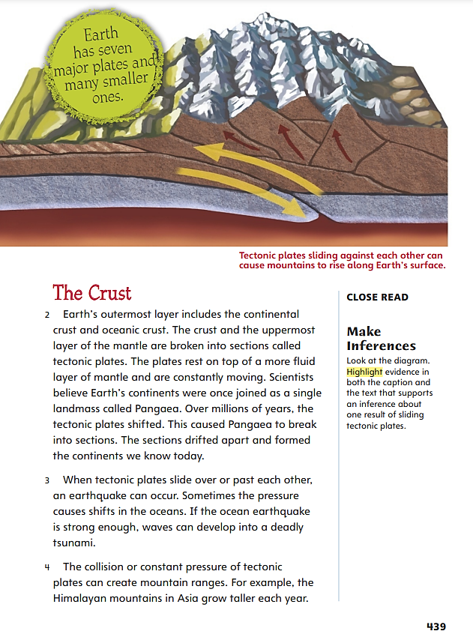
Page 439
Close Read – Make Inferences
Combine your prior knowledge and the text details you found to make inferences about the information in Planet Earth.
Notes:
Explain that good readers often combine text evidence with their prior knowledge to make an inference about a text. Inferences help readers expand their understanding of a topic.
Think of what you already know about Earth’s features and processes.
Look for details in the text, diagrams, and captions that could help you make inferences about the information in Planet Earth.
Combine your prior knowledge and the text details you found to make inferences.
Use the Close Read note on p. 439 of the Student Interactive to model the thinking behind making inferences:
Say: The caption tells me that when tectonic plates slide against each other, they cause mountains to rise on Earth’s surface. I will write this in the chart under “Text Evidence.”
Say: Next, I will write what I already know about this topic in the chart. I know mountains change over time.
Say: Finally, I will combine the text evidence I highlighted with what I already know to make an inference: Tectonic plates can cause mountains to get taller over time.

Slide 52
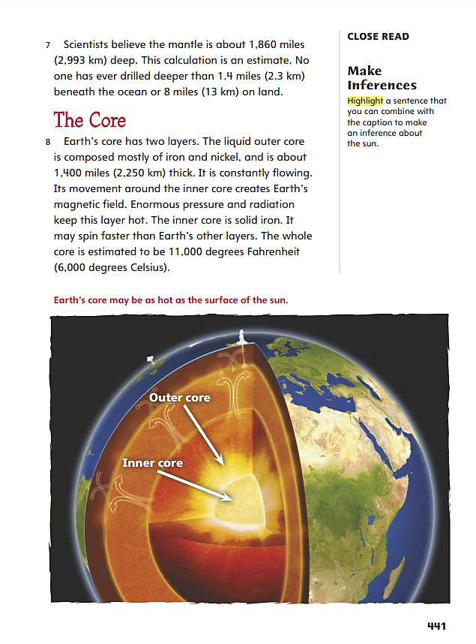
Page 441
Close Read – Make Inferences
Turn to page 441 in your Student Interactive.
Notes:
Have students annotate the text using the Close Read notes for Make Connections.
Have students scan paragraph 8 and highlight a sentence that relates to the caption in the diagram. See student page for possible responses.
Ask students what the caption and the sentence they highlighted tell them about the sun. Have students support their responses with text evidence.
Possible response: The text and the feature tell me that the temperature of the sun is about 11,000 degrees Fahrenheit. DOK 2

Slide 53
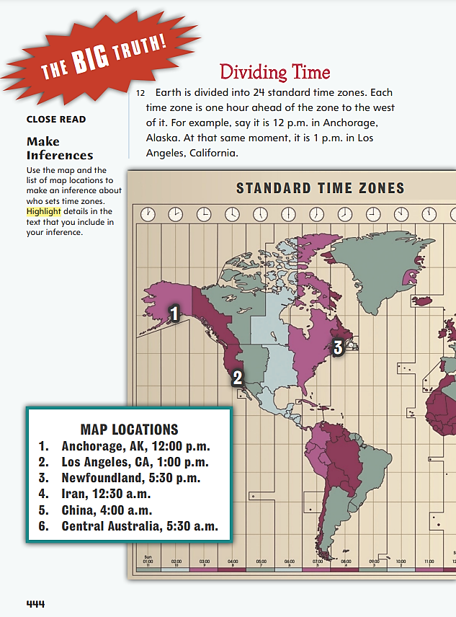
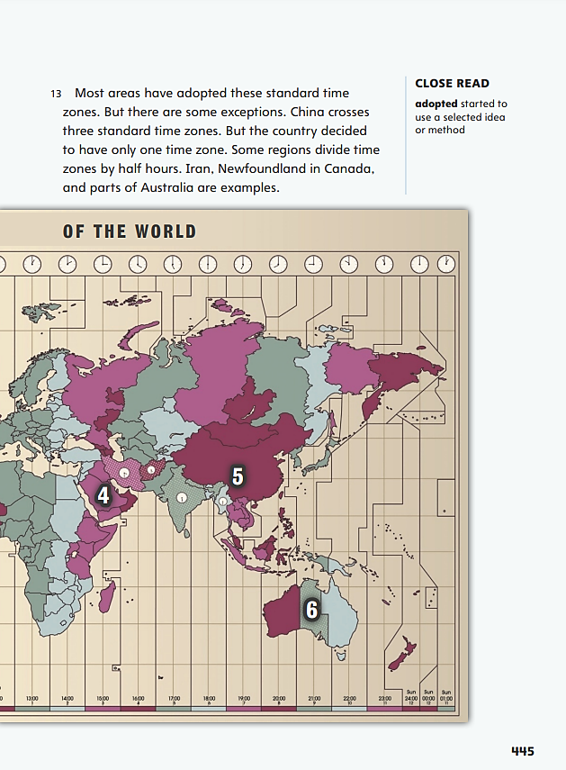
Page 445
Close Read – Make Inferences
Turn to page 445 in your Student Interactive.
Notes:
Have students annotate the text using the Close Read notes for Make Connections.
Have students scan the list of locations and paragraphs 12–13 and highlight details to include in their inference. See student page for possible responses.
Ask students to explain how the details they highlighted support their inference.
Possible response: The map and list of locations show that countries set time zones. Details about China’s one time zone and other nations’ use of half-hour time zones support my inference. DOK 2

Slide 54
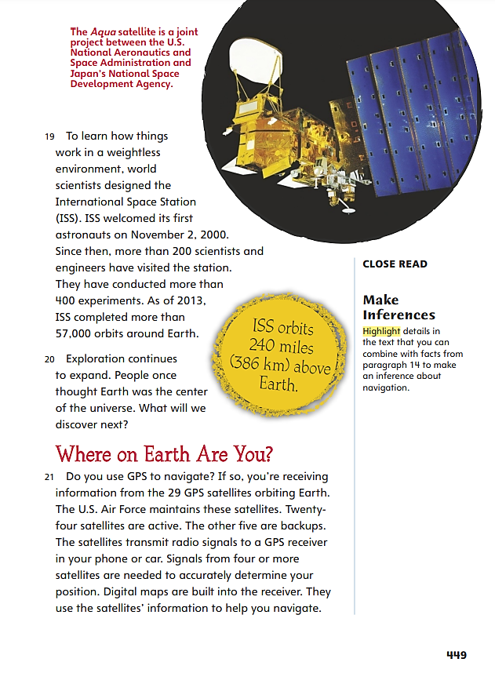
Page 449
Close Read – Make Inferences
Turn to page 449 in your Student Interactive.
Notes:
Have students annotate the text using the Close Read notes for Make Connections.
Have students scan paragraph 21 to highlight details about navigation. See student page for possible responses.
Have students consider the fact that the air force maintains U.S. satellites. Ask students what other things satellites might reveal to people.
Possible response: Satellites might also reveal weather patterns, unusual movements of many people, and actions taken by industry or the military in other nations. DOK 2

Slide 55
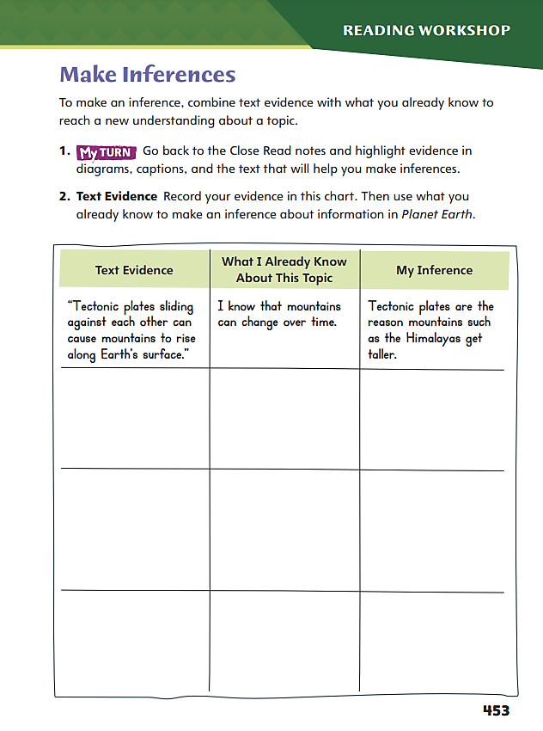
Page 453
Make Inferences
Use your annotations to fill in the graphic on p. 453 in your Student Interactive.
Notes:
Have students annotate the text using the other Make Inferences Close Read notes.
Next, have students use that text evidence from their annotations to complete p. 453.

Slide 56
Page 458
Write for a Reader
Discuss ways you can use a variety of text structures.
Notes:
Explain to students that in writing an informational text, students should be able to use a variety of text structures.
• Chronological is a good way to present a clear sequence of events.
• Authors use compare-and-contrast structure to highlight similarities, or differences, to inform readers.
• A cause-and-effect structure can help authors explain or clarify the relationship between events or ideas.
• A problem-and-solution text structure is common in argumentative and informational texts.
• A descriptive structure develops a topic by listing characteristics. This structure is well suited for giving detailed information about a narrow topic.
Discuss how students can use text structure in their own writing on p. 458 in the Student Interactive. Model an example.
Say: First I think about what I know about the health benefits of fruits and vegetables. What kinds of facts can I put together? Which text structure would best fit these facts?
Say: What is my main idea? What facts and evidence support this idea? How can I arrange these facts and evidence to inform readers?
Say: I need to be flexible. If one text structure doesn’t seem to work, I will try another. I will use a heading that helps my reader identify the text structure.

Slide 57
Page 458
Apply
Turn to page 458 in your Student Interactive and complete the activity.
Notes:
Have students review the text structure used by Christine Taylor-Butler as a model for their own writing.
Point out that students do not need to use the same structure as Christine Taylor-Butler, but their work should show the same consistency and organization as Taylor-Butler’s once a structure is chosen.

Slide 58
Word Study – Spiral Review
1. grate/great
2. pair/pear
3. claim/clam
4. to/two
5. through/thorough
6. trace/trays
7. allowed/aloud
8. night/knight
Identify whether each pair of words are homophones.
Write three sentences, each using a pair of homophones.
Share your sentences
with a partner.
Notes:
Words that are pronounced the same but have different spellings and meanings are called homophones.
Write some examples of homophones on the board: right, write, presence, presents, rap, wrap.
Ask volunteers to identify whether each pair of words are homophones.
grate/great
pair/pear
claim/clam
to/two
through/thorough
trace/trays
allowed/aloud
night/knight
Challenge students to write three sentences, each using a pair of homophones.
Have students share their sentences with a partner.

Slide 59
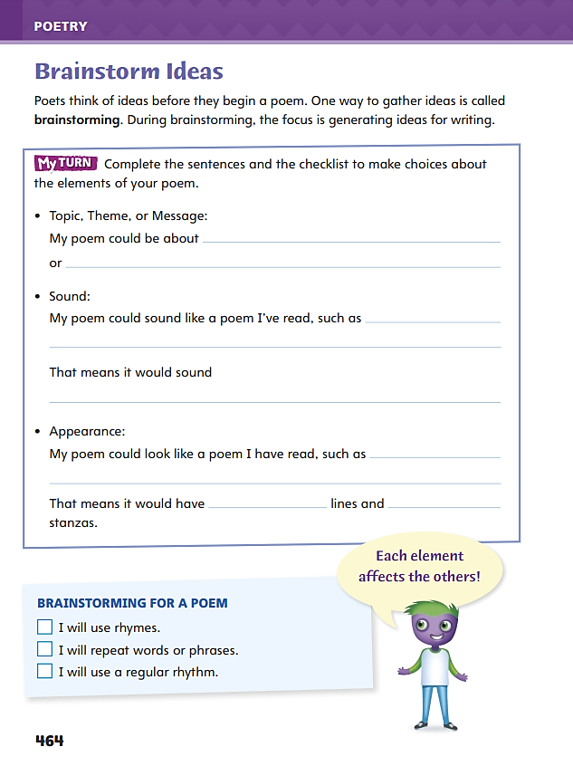
Page 464
Writing – Poetry
Turn to page 464 in your Student Interactive and complete the activity.
Notes:
Explain that like all writers, poets brainstorm ideas for their poetry. They focus on the topic (or message) of the poem, the sounds of the poem and the effect the sounds will have on the reader, and the appearance of the poem and the way the form will affect how the poem is read.
Tell students that they will be brainstorming ideas for their own poems. Emphasize that they can think about the poems they enjoyed so far to help them generate ideas for their own poems:
Ask: What topics did you enjoy from the poems we have looked at? Invite students to think about the effect the poem had on them. Ask: How did the poem make you feel? What did the poet do to achieve that?
Ask: What sounds—regular rhythms or rhymes—did you enjoy from the poems we have read? Invite students to think about the effect the sounds had on the meaning of the poem. (Did they make the poem fun or dark or sad?)
Ask: What types of poems have you enjoyed reading? Do you like poems with short lines or long lines? Is a short poem better than a poem with multiple stanzas? Remind students that the form of a poem informs how it is read.
Direct students to p. 464 in the Student Interactive. Have them complete the brainstorming activity and the checklist to generate ideas for their poem.

Slide 60
Independent Writing
Continue writing your poems. Include any new ideas from the brainstorming session in your writer’s notebooks.
Share the results of your brainstorming on the topic, sounds, and appearance of your poems.
Notes:
Transition students to independent writing. If students need to further explore brainstorming, they may use this time to do so.
If students struggle, choose one of the following options to provide further support.
Modeled - Do a Think Aloud to model reflecting on the topic, sounds, and appearance of a poem.
Shared - Have students describe topics, sounds, and appearances of poems they have read. Record their responses.
Guided - With students, generate ideas to explore for topics, rhythm patterns and rhymes, and forms or appearance of poems. Encourage students to circle or note the ones that appeal most to them.
If students have started their poems, they should continue and include any new ideas from the brainstorming session in their writer’s notebooks.
Invite partners to share the results of their brainstorming on the topic, sounds, and appearance of their poems.

Slide 61
Spelling – Spiral Review
bear
bare
Spell out the words you hear based on their definitions on a sheet of paper.
Notes:
Define homophones as words that are pronounced the same but have different spellings and meanings. Give examples: bear, bare.
Read the following words and definitions out loud, and have students spell the words on their papers.
stair (step)
stare (look)
break (destroy)
brake (slow)
bore (be tedious)
boar (wild pig)
here (at hand)
hear (listen)
principle (key rule)
principal (school leader)
Have pairs use the homophones peak/peek and rain/reign in written sentences.

Slide 62
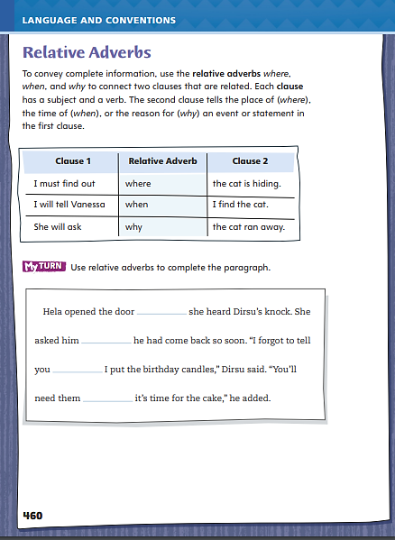
Page 460
Language and Conventions
Turn to page 460 in your Student Interactive and complete the activity.
Notes:
Have students complete Student Interactive p. 460.
As students draft their Writing Workshop texts, focus on using relative adverbs to identify when, where, and why in their writing.

Slide 63
Lesson 5

Slide 64
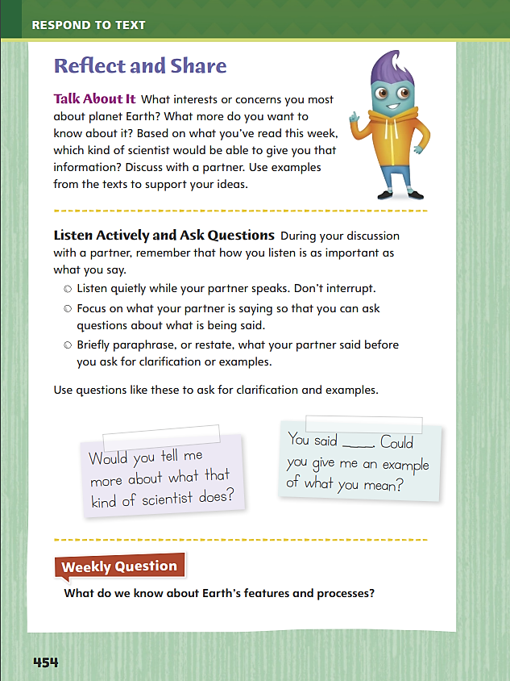
Page 454
Reflect and Share
Turn to page 454 in your Student Interactive.
Notes:
Remind students that when they participate in discussions with other readers, they should listen actively and ask questions.
Remind them that a good discussion involves both give and take, so they should be listening as much as they are talking.
Before making a comment, make sure others have finished speaking. Listening actively means not interrupting.
When another reader is speaking, focus on what he or she is saying so you can ask questions about what is being discussed.
Ask your discussion partner to explain when you don't understand a comment and add relevant thoughts of your own. This sparks useful collaboration and yields new information.
Show you listened to your partner's comments by paraphrasing what he or she said before asking for clarification or examples.
Model listening actively using the Talk About It prompt on p. 454 of the Student Interactive:
Say: If my discussion partner commented on the infographic about the percent of land surface that rain forests take up versus the percent of Earth’s species that they contain, I might say, “I thought that was interesting too. Maybe that’s why preserving rain forests is so important.”

Slide 65
Page 454
Apply
Use evidence from the text you have read this week to respond to the Weekly Question.
Write your response on a separate sheet of paper.
Notes:
Have students use discussions from this week to apply and respond to the rest of the instruction on p. 454 in the Student Interactive.
Have students use evidence from the texts they have read this week to respond to the Weekly Question. Tell them to write their response on a separate sheet of paper or discuss it in small groups.

Slide 66
Word Study – Latin Roots
unendurable
deport
inject
generic
projection
Identify the Latin root in each word. Pronounce the word aloud. Determine the meaning of the word.
Notes:
To evaluate how well students can determine the meanings of words with Latin roots, write these words on the board:
unendurable
deport
inject
generic
projection
Have students identify the Latin root in each word, pronounce the word aloud, and determine the meaning of the word.

Slide 67
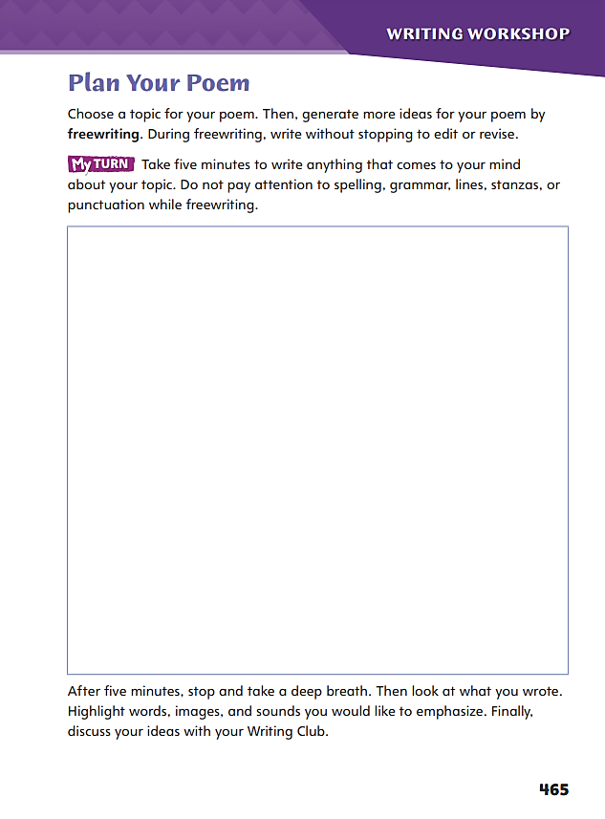
Page 465
Writing – Poetry
Turn to page 465 in your Student Interactive.
Freewrite for 5 minutes.
Circle ideas you want to revisit.
Notes:
Explain that writing poetry, like any type of writing, is a process. The first step is generating ideas. Freewriting can be a very helpful tool. Use it to explore
feelings or emotions about a topic,
images, descriptions, and details that relate to the topic or purpose of the poem and,
sounds of words, rhymes, or rhythms to incorporate in the poem.
Inform students that they will be using freewriting to help them explore the topic, ideas, and features to include in their poems.
Say: The focus of freewriting is on ideas. There is no need to worry about writing rules. Freewriting is a way to follow your thoughts and capture them in writing.
Remind students that they should write down all their thoughts. Say: Even if you are not sure you like an idea or phrase, write it down. These thoughts may lead to better ideas and can be revised later. You will also have the opportunity to share your thoughts with your classmates, and they may be able to help you revise these ideas into language you want to include in your poem.
Direct students to p. 465 in the Student Interactive. Have them freewrite for five minutes.
Then direct them as stated to note ideas they want to emphasize. Encourage them to circle ideas they want to revisit and explore further.

Slide 68
Independent Writing
Let’s explore the topic, ideas, and features to include in your poems.
Freewrite for five minutes your writing notebooks.
Note ideas you want to emphasize. Circle ideas you want to revisit and explore further.
Share your freewriting with a partner. Discuss the ideas you highlighted and want to include in your poems.
Notes:
Direct students to p. 465 in the Student Interactive. Have them freewrite for five minutes. Then direct them as stated to note ideas they want to emphasize. Encourage them to circle ideas they want to revisit and explore further.
Guide students into Writing Club groups. See p. T353 for details of how to run Writing Club.
At the end of independent writing time ask students to share their freewriting with a partner. Have them focus on the ideas they highlighted and want to include in their poems.

Slide 69
Spelling
Jory is generous with both his time and his money.
The 800-meter dash is both a sprint and an endurance race.
If you make noise during the play, they will eject you from the theater.
The senator has a major objection to the budget bill.
This leather is both beautiful and durable.
My dad once had a job running a projector in a movie theater.
This new laptop is powerful and completely portable.
The debate started out well, but soon degenerated into an argument.
In general, most of the debates were highly productive.
We need to find out how to transport a sofa to New Mexico.
Notes:
(Note: Move the orange boxes to cover each bold spelling word before you read aloud the words and sentences.)
Use the following sentences for a spelling test
Jory is generous with both his time and his money.
The 800-meter dash is both a sprint and an endurance race.
If you make noise during the play, they will eject you from the theater.
The senator has a major objection to the budget bill.
This leather is both beautiful and durable.
My dad once had a job running a projector in a movie theater.
This new laptop is powerful and completely portable.
The debate started out well, but soon degenerated into an argument.
In general, most of the debates were highly productive.
We need to find out how to transport a sofa to New Mexico.

Slide 70
Language and Conventions
Tien and Dorin rode the subway to the theater _____ Hamilton was playing.
Identify the relative adverb that best fits the sentence.
why
for
when
where
Notes:
Have students identify the relative adverb that best fits the sentence.
Tien and Dorin rode the subway to the theater _____ Hamilton was playing.
why
for
when
where
Conventions p. 187 from the Resource Download Center. Click path: Table of Contents -> Resource Download Center -> Language and Conventions -> U5 W1

Slide 71
Unit 5: Week 1
Grade 4

